Slide 1
Kademlia A Peer-to-peer Information System Based on the XOR Metric
Petar Maymounkov and David Mazières
{petar, dm}@cs.nyu.edu
http://kademlia.scs.cs.nyu.edu
IPTPS'02 (MIT), March 2002 &
Springer LNCS

Slide 2
Outline
Introduction
XOR metric
Node state
Kademlia protocol
Kademlia in the P2P system
Summary

Slide 3
Introduction (1/3)
Kademlia, a peer-to-peer (key,value) storage and lookup system.
Kademlia has a number of desirable features not simultaneously offered by any previous peer-to-peer system.
  It minimizes the number of configuration messages nodes must send to learn about each other.
  Configuration information spreads automatically as a side-effect of key lookups.
  Nodes have enough knowledge and flexibility to route queries through low-latency paths.
  Kademlia uses parallel, asynchronous queries to avoid timeout delays from failed nodes.
  Nodes record each other’s existence resists certain basic denial of service attacks.

Slide 4
Introduction (2/3)
Kademlia takes the basic approach of many peer-to-peer systems. Keys are opaque, 160-bit quantities.
Participating computers each have a node ID in the 160-bit key space. (key, value) pairs are stored on nodes with IDs “close” to the key for some notion of closeness.
A node-ID-based routing algorithm lets anyone locate servers near a destination key

Slide 5
Introduction (3/3)
Kademlia use of a novel XOR metric for distance between points in the key space.
XOR is symmetric, allowing Kademlia participants to receive lookup queries from precisely the same distribution of nodes contained in their routing tables.
To locate nodes near a particular ID, Kademlia uses a single routing algorithm from start to finish.
In contrast, other systems use one algorithm to get near the target ID and another for the last few hops.

Slide 6
XOR metric (1/3)
Each Kademlia node has a 160-bit node ID.
  Machines just choose a random,160-bit identifier when joining the system.
Every message a node transmits includes its node ID, permitting the recipient to record the sender’s existence if necessary.
Keys, too, are 160-bit identifiers.
Notes:
Explain key ,node ,value

Slide 7


XOR metric (2/3)
Given two 160-bit identifiers, x and y, Kademlia defines the distance between them as their bitwise exclusive or (XOR) interpreted as an integer,
d (x, y) = x ⊕ y.
d (x, x) = 0
d (x, y) > 0 if x ≠ y, and x, y : d (x, y) = d (y, x)
d (x, y) + d (y, z) ≧ d (x, z)
d (x, z) = d (x, y) ⊕ d (y, z) and
a≧0, b≧0 : a + b ≧ a ⊕ b.

Slide 8
XOR metric (3/3)
XOR is unidirectional.
For any given point x and distance △ > 0, there is exactly one point y such that d (x, y) = △.
Unidirectionality ensures that all lookups for the same key converge along the same path, regardless of the originating node.
Caching (key, value) pairs along the lookup path alleviates hot spots.
XOR topology is also symmetric.
  (d (x, y) = d (y, x) for all x and y)

Slide 9
Node state (1/6)
For each 0 ≦ i < 160, every node keeps a list of
(IP address, UDP port, Node ID) triples for nodes of distance between 2^{i} and 2^{i+1} from itself.
We call these lists k-buckets.
i | interval | triple
0 | [2⁰, 2¹) | (IP address,UDP port,Node ID) ₀₋₁ ...... (IP address,UDP port,Node ID) _{0-k}
1 | [2¹, 2²) | (IP address,UDP port,Node ID) ₁₋₁ ...... (IP address,UDP port,Node ID) _{1-k}
2 | [2², 2³) | (IP address,UDP port,Node ID) ₂₋₁ ...... (IP address,UDP port,Node ID) _{2-k}
…
i | [2^{i}, 2^{i+1}) | (IP address,UDP port,Node ID) _{i-1} ...... (IP address,UDP port,Node ID) _{i-k}
…
159 | [2¹⁵⁹, 2¹⁶⁰) | (IP address,UDP port,Node ID) ₁₅₉₋₁ ...... (IP address,UDP port,Node ID) _{159-k}
k-bucket

Slide 10
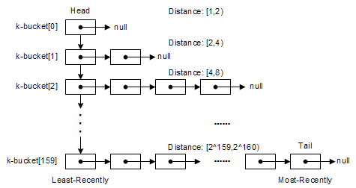
Node state (2/6)
Each k-bucket is kept sorted by time last seen.
  Least-recently seen node at the head.
  Most-recently seen at the tail.

Slide 11
Node state (3/6)
For small values of i, the k-buckets will generally be empty (as no appropriate nodes will exist).
For large values of i, the lists can grow up to size k, where k is a system-wide replication parameter.
k is chosen such that any given k nodes are very unlikely to fail within an hour of each other (for example k = 20).

Slide 12
Node state (4/6)
When a Kademlia node receives any message (request or reply) from another node, it updates the appropriate k-bucket for the sender’s node ID.
If the sending node already exists in the recipient’s k- bucket, the recipient moves it to the tail of the list.
If the node is not already in the appropriate k-bucket and the bucket has fewer than k entries, then the recipient just inserts the new sender at the tail of the list.
If the appropriate k-bucket is full, then the recipient pings the
k-bucket’s least-recently seen node to decide what to do.
  If the least-recently seen node fails to respond, it is evicted from the
  k-bucket and the new sender inserted at the tail.
  If the least-recently seen node responds, it is moved to the tail of the list, and the new sender’s contact is discarded.

Slide 13
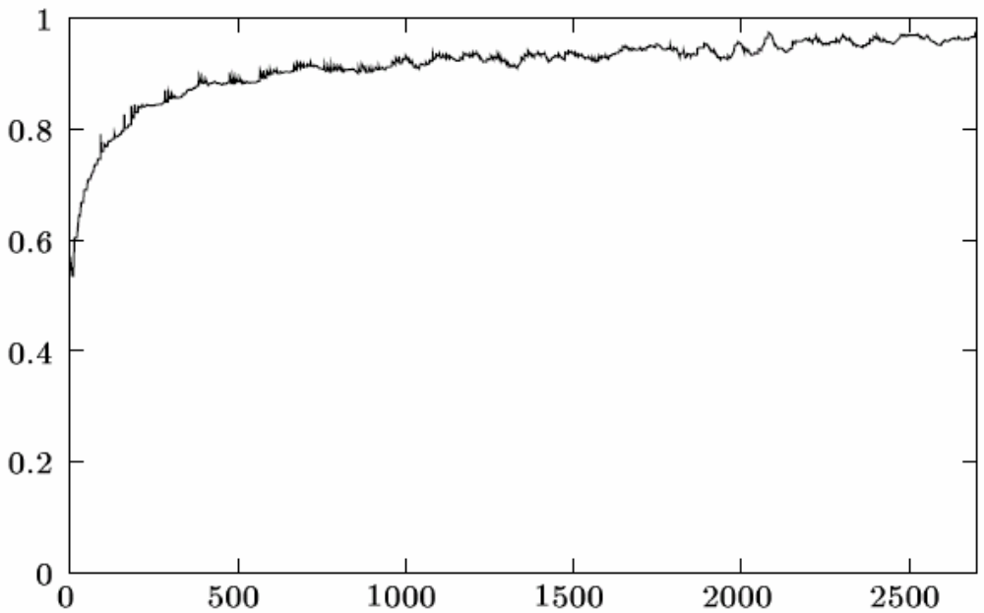
Node state (5/6)
k-buckets effectively implement a least-recently seen eviction policy, except that live nodes are never removed from the list.
This preference for old contacts is driven by our analysis of Gnutella trace data.
the fraction of nodes that stayed online at least x minutes that also stayed online at least x + 60 minutes
The longer a node has been up,
the more likely it is to remain up another hour.
minutes

Slide 14
Node state (6/6)
By keeping the oldest live contacts around,
k-buckets maximize the probability that the nodes they contain will remain online.
A second benefit of k-buckets is that they provide resistance to certain DoS attacks. One cannot flush nodes’ routing state by flooding the system with new nodes.
Kademlia nodes will only insert the new nodes in the k-buckets when old nodes leave the system.

Slide 15
Kademlia protocol (1/12)
The Kademlia protocol consists of four RPCs:
  PING
  STORE
  FIND_NODE
  FIND_VALUE.
The PING RPC probes a node to see if it is online.
STORE instructs a node to store a (key, value) pair for later retrieval.

Slide 16
Kademlia protocol (2/12)
FIND_NODE takes a 160-bit ID as an argument.
The recipient of a the RPC returns
(IP address, UDP port, Node ID) triples for the
k nodes it knows about closest to the target ID.
These triples can come from
  A single k-bucket.
  Multiple k-buckets if the closest k-bucket is not full.
In any case, the RPC recipient must return k items.
  Unless there are fewer than k nodes in all its k-buckets combined, in which case it returns every node it knows about.

Slide 17
Kademlia protocol (3/12)
FIND_VALUE behaves like FIND_NODE — returning (IP address, UDP port, Node ID) triples — with one exception.
  If the RPC recipient has received a STORE RPC for the key, it just returns the stored value.
In all RPCs, the recipient must echo a 160-bit random RPC ID, which provides some resistance to address forgery.
PINGs can also be piggy-backed on RPC replies for the RPC recipient to obtain additional assurance of the sender’s network address.

Slide 18
Kademlia protocol (4/12)
The most important procedure a Kademlia participant must perform is
to locate the k closest nodes to some given node ID.
    Node lookup.
Kademlia employs a recursive algorithm for node lookups.
Notes:
換掉?

Slide 19
Kademlia protocol (5/12)
If node X lookup for node Y which ID is t
Calculate distance to t: d (x, y) = x ⊕ y
The lookup initiator
  picking (α=3) nodes from its closest non-empty k-bucket and
  sends FIND_NODE RPCs to the α nodes it has chosen.
  If that bucket has fewer than α entries, it just takes the closest nodes it knows of.
For all node received FIND_NODE RPC
  If the node itself is t, return that it is the closest node to t.
  Otherwise, measure the distance between t and itself and pick information of α nodes from it’s k-buckets.
The initiator resends the FIND_NODE to nodes it has learned about from previous RPCs and repeat procedure 1.
The lookup terminates when the initiator has queried and gotten responses from the k closest nodes it has seen.
Notes:
換掉?

Slide 20
Kademlia protocol (6/12)
Nodes that fail to respond quickly are removed from consideration until and unless they do respond.
α is a system-wide concurrency parameter, such as 3.
Notes:
圖解?動畫?

Slide 21
Kademlia protocol (7/12)
To store a (key, value) pair, a participant locates the k closest nodes to the key and sends them STORE RPCs.
Each node re-publishes the (key, value) pairs that it has every hour.
This ensures persistence of the (key, value) pair with very high probability.
We also require the original publishers of a (key, value) pair to republish it every 24 hours.
  Otherwise, all (key, value) pairs expire 24 hours after the original publishing, in order to limit stale information in the system.
In order to sustain consistency in the publishing-searching life-cycle of a (key, value) pair, we require that whenever a node w observes a new node u which is closer to some of w’s (key, value) pairs,
w replicates these pairs to u without removing them from its own database.
Notes:
Persistence 持續存在

Slide 22
Kademlia protocol (8/12)
To find a (key, value) pair, a node starts by performing a lookup to find the k nodes with IDs closest to the key.
  However, value lookups use FIND_VALUE rather than FIND_NODE RPCs.
  Moreover, the procedure halts immediately when any node returns the value.
For caching purposes, once a lookup succeeds, the requesting node stores the (key, value) pair at the closest node it observed to the key that did not return the value.

Slide 23
Kademlia protocol (9/12)
Because of the unidirectionality of the topology, future searches for the same key are likely to hit cached entries before querying the closest node.
During times of high popularity for a certain key, the system might end up caching it at many nodes.
To avoid “over-caching,” we make the expiration time of a (key, value) pair in any node’s database exponentially inversely proportional to the number of nodes between the current node and the node whose ID is closest to the key ID.

Slide 24
Kademlia protocol(10/12)
Buckets will generally be kept constantly fresh, due to the traffic of requests traveling through nodes.
To avoid cases when no traffic exists
  Each node refreshes a bucket in whose range it has not performed a node lookup within an hour.
Refreshing means
  Picking a random ID in the bucket’s range.
  Performing a node search for that ID.

Slide 25
Kademlia protocol (11/12)
To join the network, a node u must have a contact to an already participating node w.
  u inserts w into the appropriate k-bucket.
  u then performs a node lookup for its own node ID.
  u refreshes all k-buckets further away than its closest neighbor. During the refreshes,
    u populates its own k-buckets.
    u inserts itself into other nodes’ k-buckets as necessary.

Slide 26
Kademlia protocol (12/12)
The routing table is a binary tree whose leaves are k-buckets.
160 bit
1
0
1
0
1
0
1
0

Slide 27
Kademlia in the P2P system (1/3)
A Kademlia network can have more than one table.
In the eMule, a P2P file exchange software, Kademlia network has two tables:
  Key words table
  Data index table

Slide 28
Kademlia in the P2P system (2/3)
Key words table:
To Find: Wii tips and tricks.pdf
Key words: Wii, tricks
Key words table
Key | Value
Hash(Wii)
Hash(Wii)
(data name, data length, Hash(data))
(I Love Wii.txt, 30, 1011…001)
(Wii tips and tricks.pdf, 375, 1110…101)
Hash()=>SHA1_{160bit}
Hash(trick)
Key | Value
Hash(tricks)
(data name, data length, Hash(data))
(Wii tips and tricks.pdf, 375, 1110…101)
(Card trick.mpg, 65000, 1000…100)

Slide 29
Kademlia in the P2P system (3/3)
Data index table:
To Find: 1110…101
Data index table
Key | Value
1011…101
1011…101
(IP, UDP Port, node ID)
(218.164.185.90, 3347, 1011…001)
(125.230.122.183, 3475, 1011…011)

Slide 30
Summary (1/1)
With its novel XOR-based metric topology, Kademlia is the first peer-to-peer system to combine provable consistency and performance, latency-minimizing routing, and a symmetric, unidirectional topology.
Kademlia is the first peer-to-peer system to exploit the fact that node failures are inversely related to uptime.

